Slide 1
Lesson 9 - Using Functions
Mack 2021

Slide 2
Functions and Parameters
def print_number(num):
print(num)
Notes:
Let’s review functions. We’ve used plenty of built-in functions up to this point, but now we are going to define and call our own functions.

Slide 3
Functions and Parameters
def print_number(num):
print(num)
Notes:
To define a function, we use the keyword def

Slide 4
Functions and Parameters
def print_number(num):
print(num)
Notes:
- then we name the function.

Slide 5
Functions and Parameters
def print_number(num):
print(num)
Notes:
The parenthesis holds our parameter

Slide 6
Functions and Parameters
def print_number(num):
print(num)
Notes:
and we finish up with a colon.

Slide 7
Functions and Parameters
def print_number(num):
print(num)
Notes:
Below this, and indented, we tell python what we want this function to do by telling it what to do with the parameter. Here, we simply want python to print the parameter.
Now, defining a function won’t do anything unless the function is called.

Slide 8
Functions and Parameters
10
def print_number(num):
print(num)
print_number(10)
Notes:
Here, the function is called with the number 10 as the argument. An argument is the actual value that takes place of the parameter. So, here num is the parameter and 10 in the argument. When this function is called, the argument, or in this case, a 10 will be printed.

Slide 9
Functions and Parameters
10
20
def print_number(num):
print(num)
print_number(10)
print_number(20)
Notes:
We can continue using this function with different arguments!

Slide 10
Functions and Parameters
10
20
30
def print_number(num):
print(num)
print_number(10)
print_number(20)
print_number(30)
Notes:
We can continue using this function with different arguments!

Slide 11
def difference(first, second):
print (first - second)
difference(10, 4)
Functions and Parameters
Functions can also have multiple parameters. The parameter names are separated by commas.
6
Notes:
Multiple parameters can also be used. This will happen often in data science as you might want to compare two different columns, or perform a calculation using the values in two different columns. Here, we are taking the difference between the first and second parameters. If we call this function with the arguments, of 10 and 4 - the function will print 6.

Slide 12
def difference(first, second):
return (first - second)
difference(10, 4)
print (difference(10, 4))
Return values
Here is a function that has a parameter and a return value.
6
Notes:
There’s a small difference in this function. Do you see it? Here, we are using a return statement instead of a print statement. In this case, nothing will print when we call the function. The result is simply stored. We can print the result by adding a print statement.

Slide 13
def difference(first, second):
return (first - second)
answer = difference(10, 4)
print(answer)
Return values
Here is a function that has a parameter and a return value.
6
Notes:
Or we can also store the return value in a variable and then print the variable. Let’s see how a function like this could work in a data science problem.

Slide 14
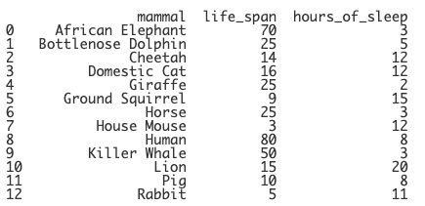
DataFrame Functions
data = {"mammal": ["African Elephant", "Bottlenose Dolphin", "Cheetah", "Domestic Cat", "Giraffe", "Ground Squirrel", "Horse", "House Mouse", "Human", "Killer Whale", "Lion", "Pig", "Rabbit"],
"life_span": [70, 25, 14, 16, 25, 9, 25, 3, 80, 50, 15, 10, 5],
"hours_of_sleep": [3, 5, 12, 12, 2, 15, 3, 12, 8, 3, 20, 8, 11]}
mammals = pd.DataFrame(data)
print(mammals)
Notes:
Let’s go back to our mammals DataFrame. We have the life span and the number of hours of sleep for each mammals. We can create a new column that will list an estimate of how many hours of each mammal’s life are spent sleeping using this information.

Slide 15
DataFrame Functions
def total_sleep(span, hours):
Notes:
First, we’ll define a function that will take in two parameters. The name of the function and the parameters can be anything you’d like. It’s helpful to keep them short but descriptive.

Slide 16
DataFrame Functions
def total_sleep(span, hours):
return span * 365 * hours
Notes:
Then, we want to return how much each mammal sleeps in their lifetime. We can find this by taking their lifespan, multiplying it by the 365 days in the year and then also multiplying by the number of hours of sleep. Perfect. We now have our function.

Slide 17
DataFrame Functions
def total_sleep(span, hours):
return span * 365 * hours
mammals["total_sleeping_hours"] =
Notes:
We can now use this function to create a new column called total_sleeping_hours. To create a new column, we call on the DataFrame mammals and then put the name of the new column in brackets and quotes.

Slide 18
DataFrame Functions
def total_sleep(span, hours):
return span * 365 * hours
mammals["total_sleeping_hours"] = total_sleep( )
Notes:
We call the function total_sleep and we want the arguments to be taken from columns of the table.

Slide 19
DataFrame Functions
def total_sleep(span, hours):
return span * 365 * hours
mammals["total_sleeping_hours"] = total_sleep(mammals["life_span"], )
Notes:
The span parameter will represent the values in in life_span column. We can denote that by typing in the DataFrame variable mammals and the name of the column. Remember to include brackets and quotes here.

Slide 20
DataFrame Functions
def total_sleep(span, hours):
return span * 365 * hours
mammals["total_sleeping_hours"] = total_sleep(mammals["life_span"], mammals["hours_of_sleep"])
Notes:
The hours parameter will represent the values in the hours_of_sleep column.

Slide 21
DataFrame Functions
def total_sleep(span, hours):
return span * 365 * hours
mammals["total_sleeping_hours"] = total_sleep(mammals["life_span"], mammals["hours_of_sleep"])
Notes:
To understand this clearer, here you can see that the values of the life_span column will be used for the parameter span in the function.

Slide 22
DataFrame Functions
def total_sleep(span, hours):
return span * 365 * hours
mammals["total_sleeping_hours"] = total_sleep(mammals["life_span"], mammals["hours_of_sleep"])
Notes:
And the values of the hours of sleep column will be used for the parameter hours in the function.

Slide 23
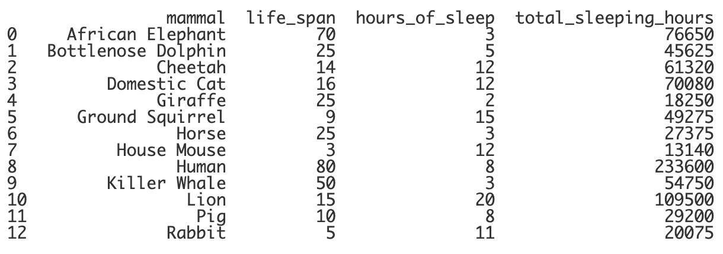
DataFrame Functions
def total_sleep(span, hours):
return span * 365 * hours
mammals["total_sleeping_hours"] = total_sleep(mammals["life_span"], mammals["hours_of_sleep"])
print(mammals)
Notes:
Lastly, let’s print the table and see the results!
We’ll take a look at a few other functions that we can use in the next live code example.

Slide 24
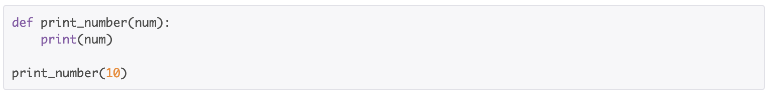
What is the parameter of the function shown in this code snippet?
Notes:
🍐 This is a Pear Deck Multiple Choice Slide. Your current options are: A: 10, B: def, C: num, D: print_number,
🍐 To edit the type of question or choices, go back to the "Ask Students a Question" in the Pear Deck sidebar.

Slide 25
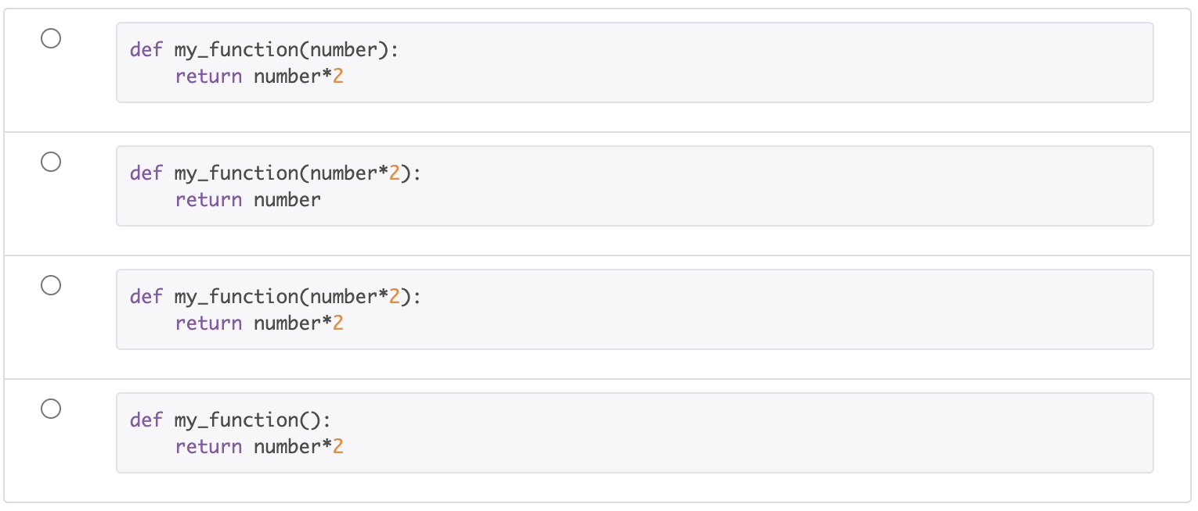
Which of the following functions successfully returns double the variable number?
Notes:
🍐 This is a Pear Deck Multiple Choice Slide. Your current options are: A: A, B: B, C: C, D: D,
🍐 To edit the type of question or choices, go back to the "Ask Students a Question" in the Pear Deck sidebar.

Slide 26
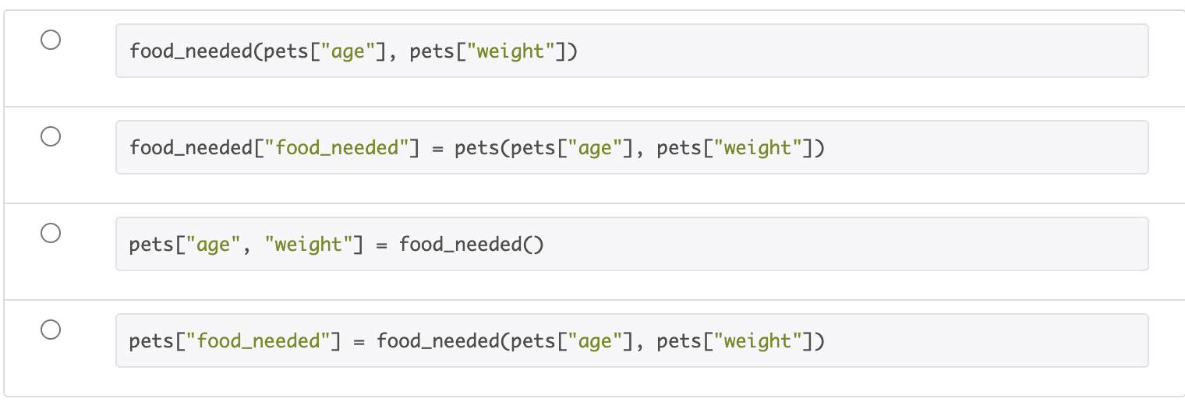
Which option would correctly create a new column by using the function food_needed and the values in the age and weight columns?
Notes:
🍐 This is a Pear Deck Multiple Choice Slide. Your current options are: A: A, B: B, C: C, D: D,
🍐 To edit the type of question or choices, go back to the "Ask Students a Question" in the Pear Deck sidebar.

